Slide 2

Your Name
Your Role
Interesting Fact
Favorite Text Editor
Notes:
Have your participants introduce themselves. The favorite text editor is a good ice breaker and it also provides you with valuable information about your students experience level. If anyone says "Notepad" or "Um…I don't know" it means they don't write code that often (if at all). Try and seat these people next to someone who answers with vim, emacs, Visual Studio Code, etc.

Slide 3
Notes:
Terraform! Today we’ll be showing you how to use Terraform to provision and update Azure resources.

Slide 4
Chapter Goals
Introduction to Infrastructure as Code
Provision to Azure
Basic Blocks of Terraform
Fire It Up!
Quiz
Notes:
Chapter 1 provides an introduction to Infrastructure as Code. After that we’ll talk about provisioning and build and run a basic Terraform plan.

Slide 5
Introduction

Slide 6
What is Infrastructure as Code
Infrastructure as Code (IaC) is the process of managing and provisioning computer data centers through machine-readable definition files.
Notes:
Some other ways to describe this:
Executable documentation
Easy to read, easy to write
Both machine and human friendly
It’s like the DNA of your infrastructure

Slide 7
Infrastructure as Code
Provide a codified workflow to create infrastructure
Expose a workflow for managing updates to existing infrastructure
Integrate with application code workflows (Git, SCM, Code Review)
Provide modular, sharable components for separation of concerns
Notes:
What are some of the benefits of infrastructure as code?
You can store it
You can version it
You can test it
You can share it
You can collaborate together on it
You can run it in different environments
You can easily recreate any resource or group or resources

Slide 8
Provisioning a Virtual Machine
Name
Operating System (Image)
Size
Location
Username and Password
Notes:
How do you stand up a new Azure VM? The user needs to provide some basic information in the portal.

Slide 9
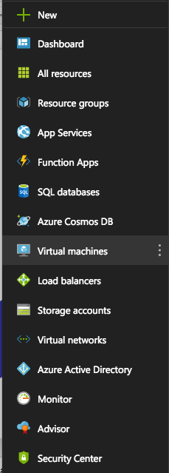
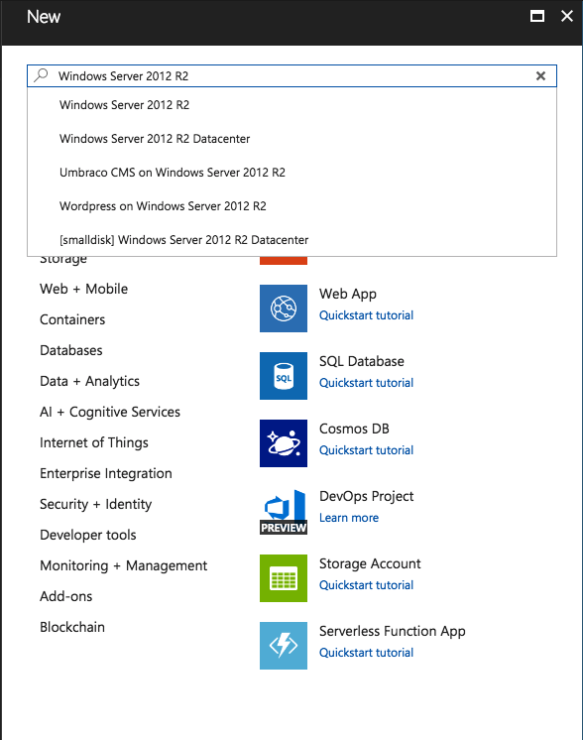
Notes:
Here we are in the Azure portal…you simply select Virtual Machines, then search for the type of VM you want to create. It’s easy! But it doesn’t scale well. Building VMs by hand is not recommended except for dev and experimentation.
Also note that there are several other parts to creating that single VM that are hidden away from the end user by the GUI. You need a resource group, virtual network, subnet, security group, network interface, storage, and a public IP address before you can set up your VM. The "simple" GUI can build these things for you, but it doesn't scale that well, and is certainly not designed for automation.

Slide 10
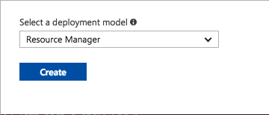
Notes:
Hit that Create button and off you go! You’re in the cloud! Wheeeeee….isn’t this fun?

Slide 11
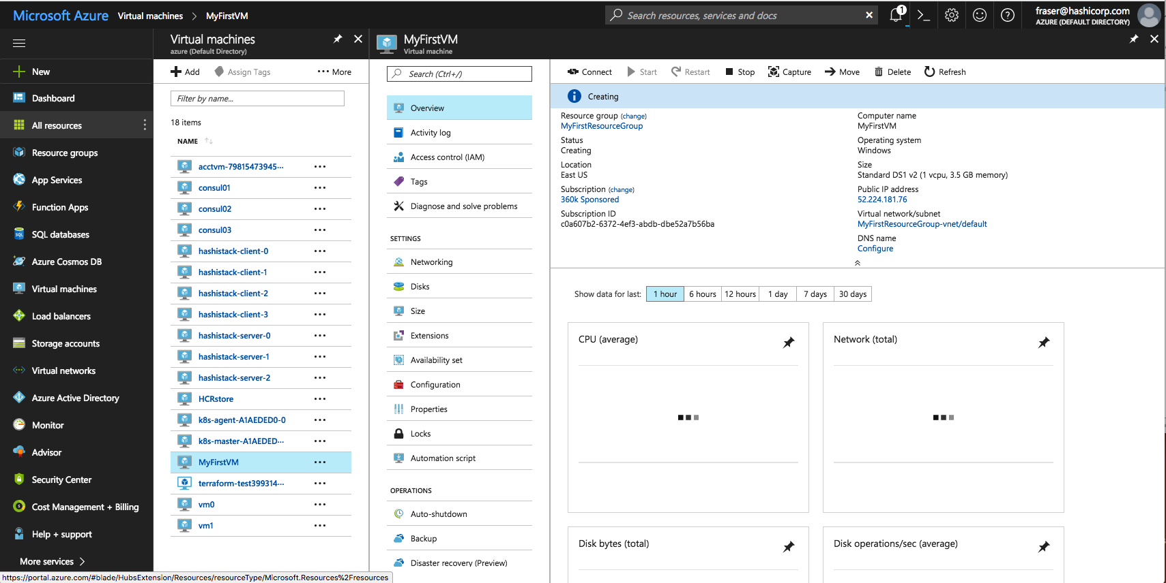
Notes:
Let’s take a closer look at this VM we created. It has all kinds of attributes, some of which are shown here in the portal. Now let’s take a look at what this might look like if we did it in Terraform.

Slide 12
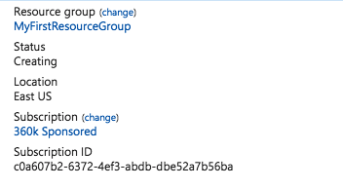
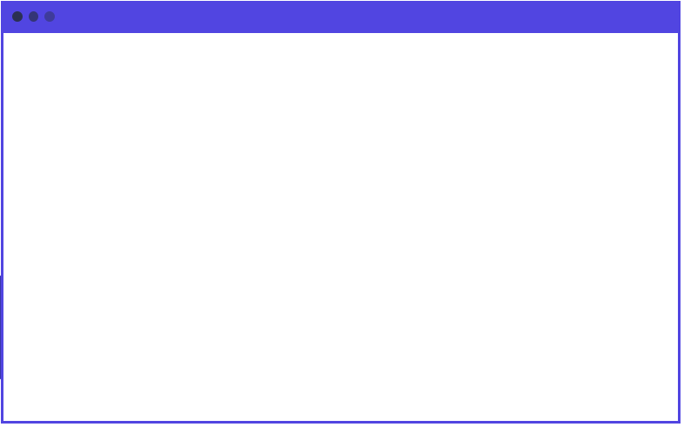
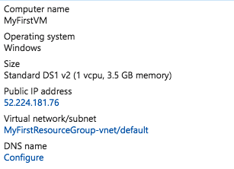
main.tf
resource "azure_instance" "web" {
name = "MyFirstVM"
image = "Windows 2012 R2"
size = "Standard DS1"
location = "East US"
username = "John Doe"
password = "Iamrootfearme!"
}
Notes:
On the left you can see a screen capture of the Azure portal. On the right is the equivalent Terraform code that could build this VM.

Slide 13
main.tf
resource "azure_instance" "web" {
name = "MyFirstVM"
image = "Windows 2012 R2"
size = "Standard DS1"
location = "East US"
username = "John Doe"
password = "Iamrootfearme!"
}
Notes:
See how the name, image, and size all map to the current config.

Slide 14
What is Terraform
Terraform is a tool for building, changing, and versioning infrastructure safely and efficiently.
Notes:
Like the name implies, Terraform lets you build things from raw resources. In this example our raw resources are compute, disk and storage on the Azure cloud.

Slide 15
Terraform and Infrastructure as Code
Infrastructure is described using a high-level configuration syntax. This allows a blueprint of your datacenter to be versioned and treated as you would any other code. Additionally, infrastructure can be shared and re-used.

Slide 16
Infrastructure as Code (Terraform)
Human-readable configuration (HCL) is designed for human consumption so users can quickly interpret and understand their infrastructure configuration.
HCL includes a full JSON parser for machine-generated configurations.
Notes:
HCL is easy to learn, easy to read, and easy to write. There are also plugins for Visual Studio Code:
https://marketplace.visualstudio.com/items?itemName=mauve.terraform

Slide 17

Azure - Resource Group
A group of related resources for an Azure solution:
The resource group can include all resources for the solution or only those you want to manage as a group
You decide how you want to allocate resources to resource groups based on what makes sense for you!
Notes:
This is one of my favorite features of Azure. It allows you to easily manage logically grouped collections of resources as a single unit.
https://docs.microsoft.com/en-us/azure/azure-resource-manager/resource-group-overview#resource-groups
Since they are mutable, you can add or remove things from a resource group, yet still maintain the ability to manage the entire thing as a single unit.

Slide 18
Azure - Resource
A manageable item that is available through Azure. Some common resources are:
Virtual machine
Storage Account
Virtual Network/Subnet
Notes:
These are the bits and pieces of your infrastructure. Think LEGO bricks that you can assemble together in different ways.

Slide 19
Workstation Setup
Notes:
Let’s get hands on with Terraform! Ladies, Gentlemen, start up your laptops.

Slide 20
Exercise: Install Terraform
Download the Terraform binary for Windows 64-bit
Create a directory at C:\bin (or wherever you like)
Unzip the Terraform binary into C:\bin
Add C:\bin to your system path variable
Notes:
The first thing we’re going to do is install Terraform. Terraform ships as a single binary that includes everything you need to run it. There’s no installer, no dll files, and no external dependencies. You can run it on any modern version of Windows, OSX, or Linux.
The installation process is basically:
Download it
Unzip it
Copy it somewhere you can run it
Make sure that it’s in your executable path
This is the hardest part of installation.

Slide 21
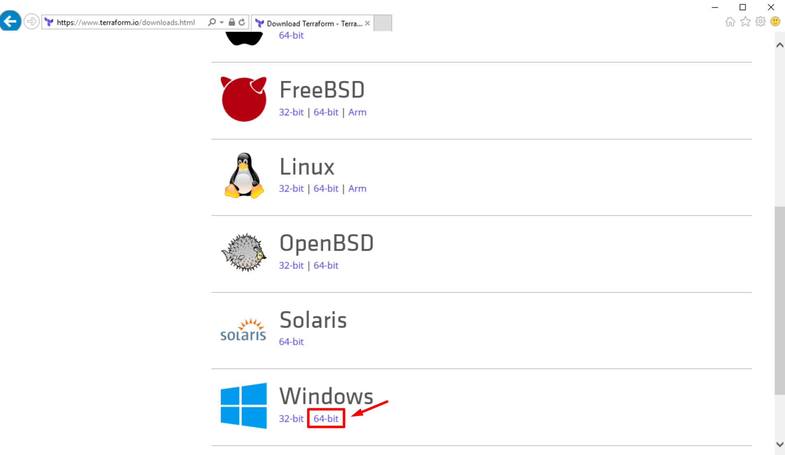
Download Terraform
https://terraform.io/downloads.html
Notes:
Make sure and download the 64 bit version for Windows. Terraform is shipped as a single binary, inside of a zip archive.

Slide 22
Powershell
PS> cd C:\
PS> mkdir bin
Notes:
Here is the sample Terraform configuration file we reviewed earlier. Let's take a moment to review the components here.

Slide 23
Powershell
PS> cd ~/Downloads
PS> Expand-Archive .\terraform_0.11.7_windows_amd64.zip
PS> cp .\terraform_0.11.7_windows_amd64\terraform.exe C:\bin
PS>
Hint: Use <TAB> completion to type fewer keystrokes.
Notes:
Here is the sample Terraform configuration file we reviewed earlier. Let's take a moment to review the components here.

Slide 24
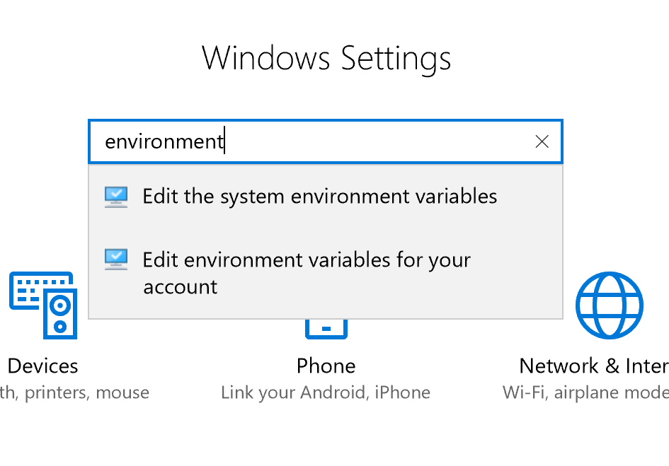
Add C:\bin to your system path
Notes:
In Windows Settings search for 'environment'

Slide 25
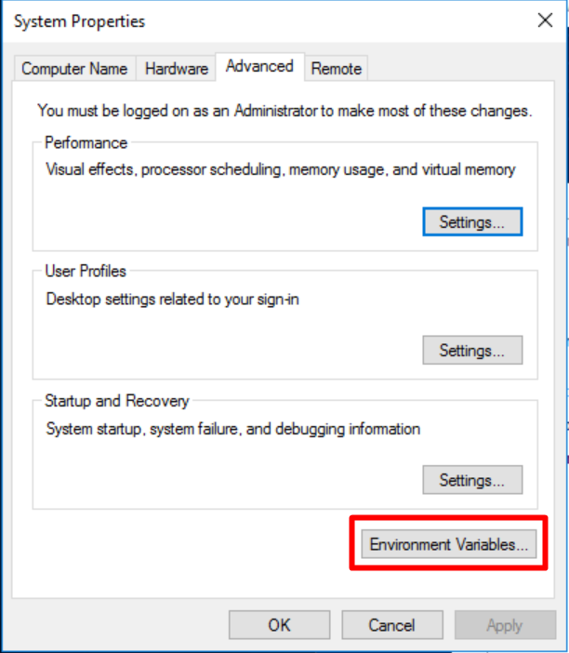
Add C:\bin to your system path
Notes:
Select "Environment Variables"

Slide 26
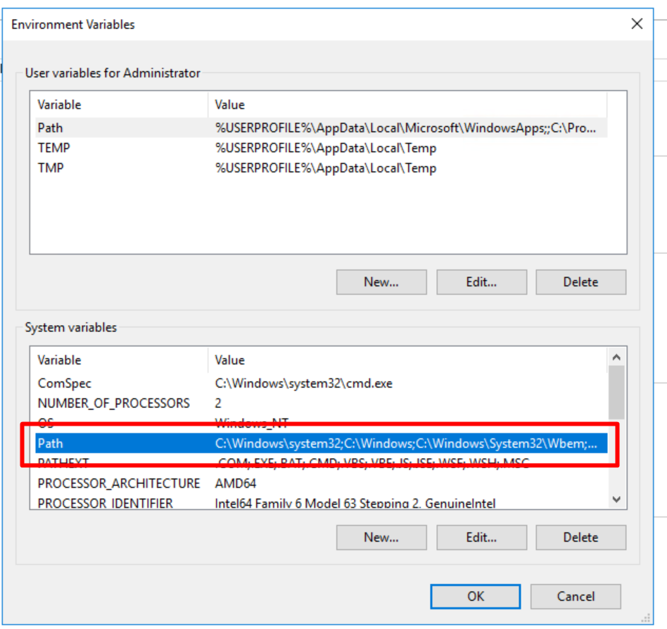
Add C:\bin to your system path
Notes:
Select the "Path" variable under System Variables

Slide 27
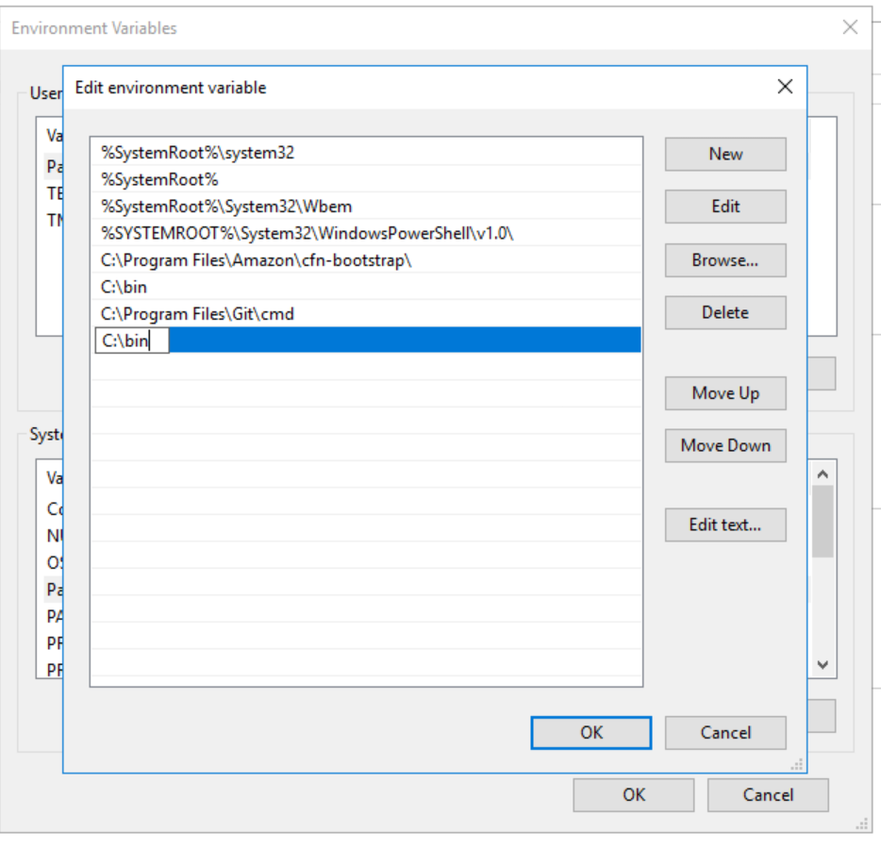
Add C:\bin to your system path
Notes:
Use the "New" button to create a C:\bin entry in your path. This allows Terraform to be run from any powershell prompt.

Slide 28
Powershell
PS> terraform --version
Terraform v0.11.7

Slide 29
Exercise: Install Visual Studio Code
Download Visual Studio Code
Install Git (optional)
Install the Terraform and Azure Terraform plugins

Slide 30
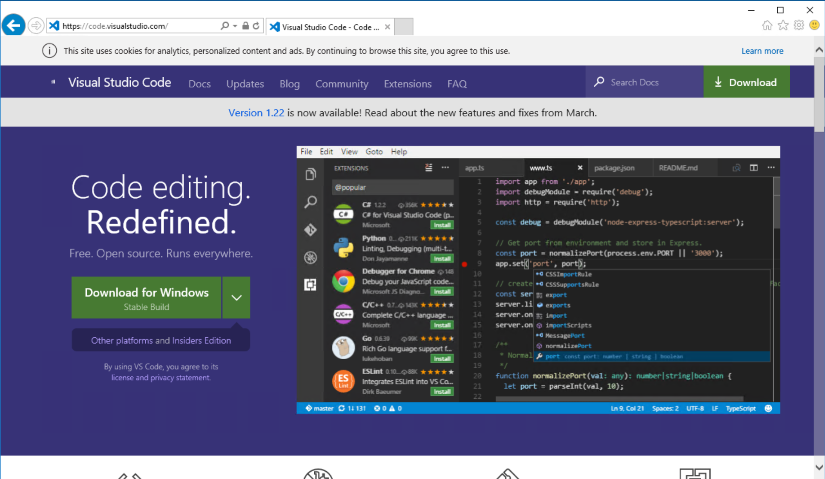
Step 1: Download and Install Visual Studio Code
code.visualstudio.com
Notes:
Make sure and download the 64 bit version for Windows.

Slide 31
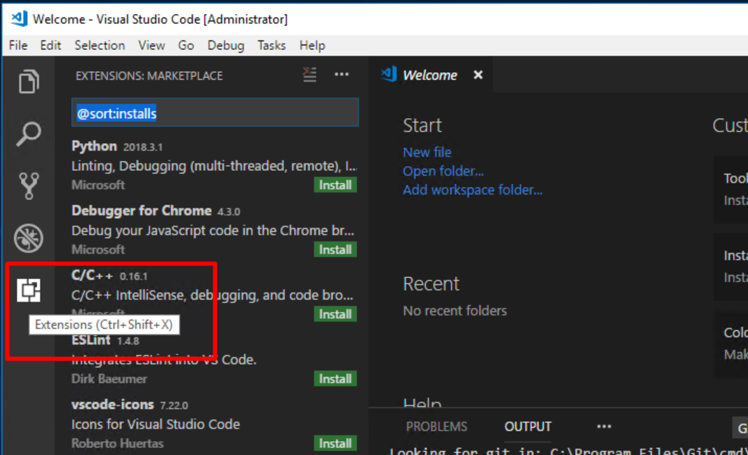
Step 2: Install VSC Terraform Extensions

Slide 32
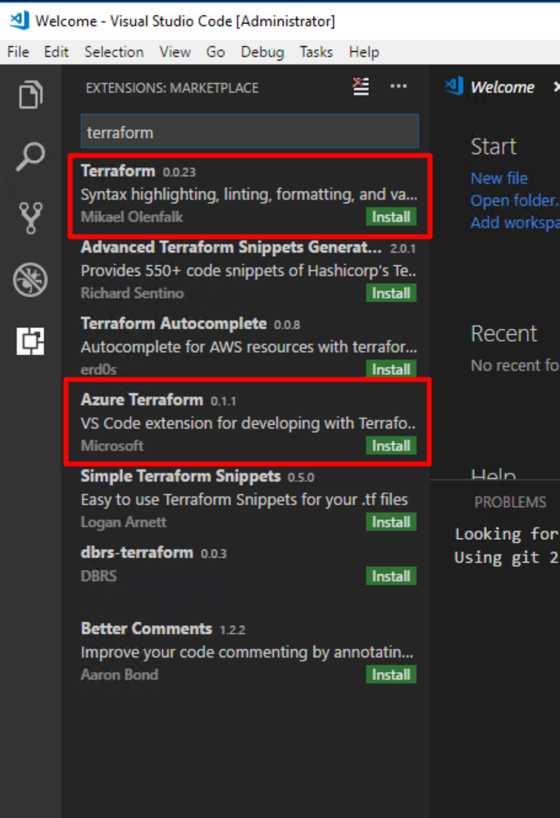
Step 3: Install VSC Terraform Extensions
Notes:
Search for ‘terraform’ in the extensions marketplace. Install both the Terraform and Azure Terraform extensions. Restart VSC or reload your extensions.

Slide 33
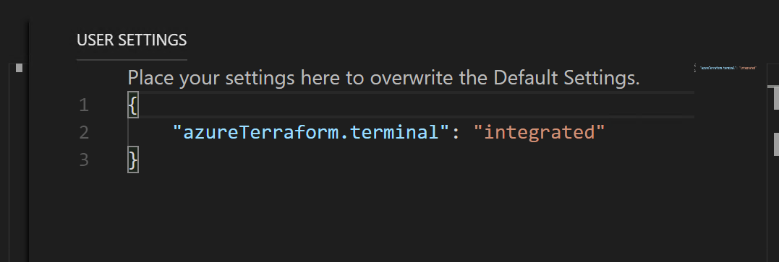
Step 4: Configure your Terminal
Select File >> Preferences >> Settings
Make your settings look like this:
Notes:
Cloudshell is kind of cool but this seems simpler and more straightforward. Valid options here are ‘integrated’ and ‘cloudshell’. If you use the local shell you can use the CTRL-SHIFT-P shortcut to run Azure Terraform commands.

Slide 34
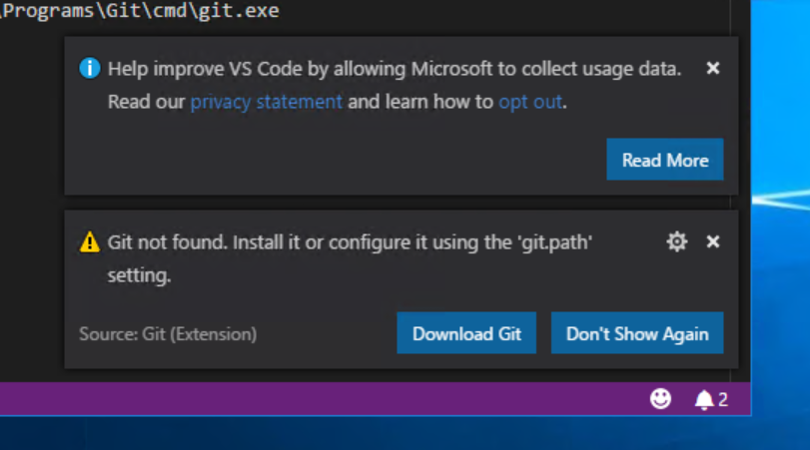
Optional: Install Git for Windows
Notes:
Make sure and download the 64 bit version for Windows. Terraform is shipped as a single binary, inside of a zip archive.

Slide 35
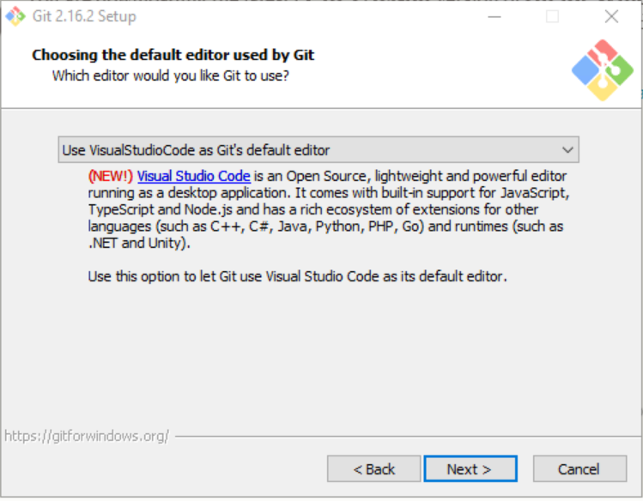
Optional: Install Git for Windows
Notes:
This is the only option you will need to change from defaults. Much nicer to use VSC as your git editor instead of nano or whatever.

Slide 36
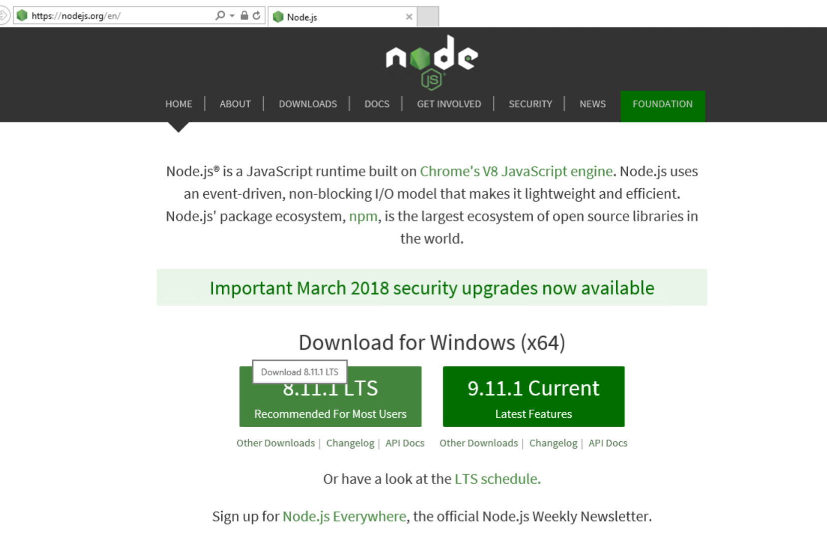
Optional: Install Node.js to enable Cloud Shell
Notes:
This lets you use Cloud shell right inside VSC. Slick. Not required.

Slide 37
Exercise: Install the Azure CLI
Download the Azure CLI MSI installer: https://bit.ly/2EU4gcX
In Visual Studio Code, open Terminal. CTRL-J will pop up the console/debug panel.
Run `az login` at the command prompt
Notes:
Worth pointing out here that you can stay completely within VSC and use the built-in Terminal for all your powershell.

Slide 38
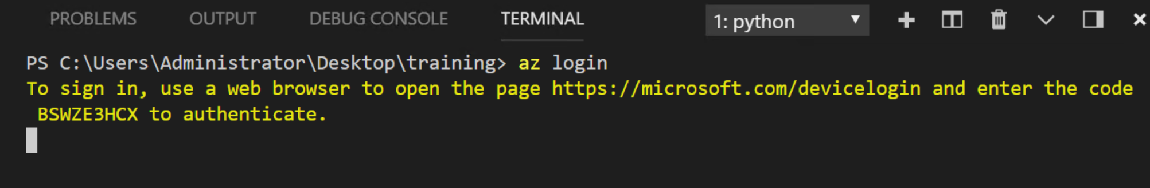
Exercise: Log onto Azure
Notes:
You’ll obviously require a valid subscription and login to do this step.

Slide 39
Exercise: Create a Workspace
Create a directory on your desktop called training
Right-click the training directory and select ‘Open with Code’
Select ‘File’ > ‘Save Workspace As’ and name it my_workspace
Notes:
Now you can come back to your project at any time. Just double-click the ‘my_workspace’ icon on the desktop.

Slide 40
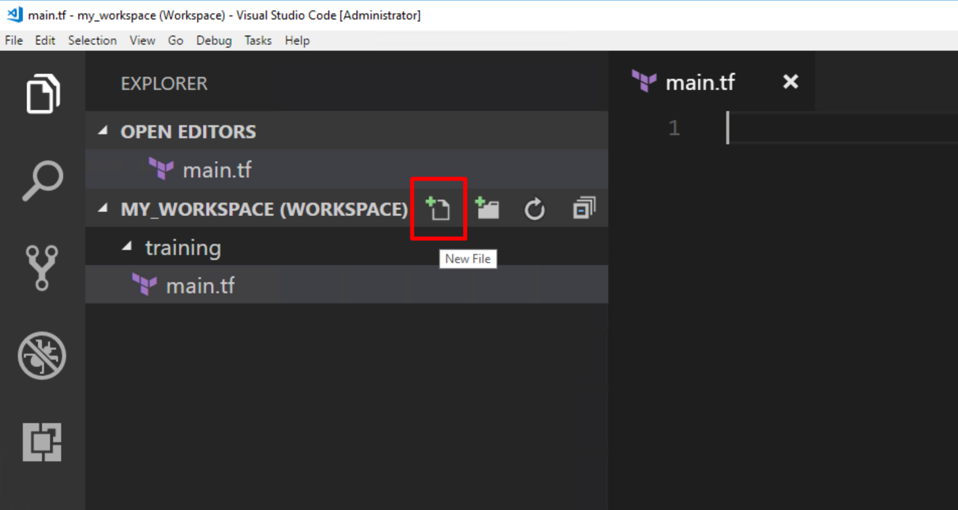
Exercise: Create a file called main.tf
Notes:
You can do everything you need from within VSC, including creating and deleting files.

Slide 41
main.tf
resource "azurerm_resource_group" "myfirstrg" {
name = "myfirstresourcegroup00"
location = "East US"
}
Notes:
Make your main.tf file look like this. Try making a typo on purpose (or by mistake). Notice how the terraform plugin will catch it and correct you.

Slide 42
Group Lab
Terraform Init
Terraform Plan
Terraform Apply

Slide 43
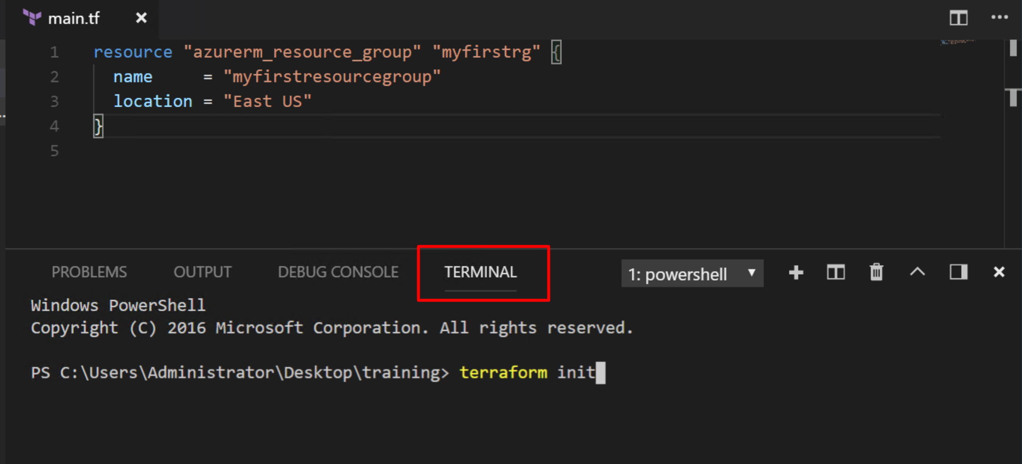
Exercise: Open a Powershell Terminal in VSC
Notes:
Use CTRL-J to pop open the debug console and terminal. Now you don’t have to leave VSC for anything!

Slide 44
Exercise: Run terraform init
Run the terraform init command to download the required providers.

Slide 45
PS> terraform init
Initializing provider plugins...
Checking for available provider plugins on http://release…
- Downloading plugin for provider "azurerm" (0.3.3)...
The following providers do not have any version constraints in configuration,so the latest version was installed.
To prevent automatic upgrades to new major versions that may contain breakingchanges, it is recommended to add version = "..." constraints to thecorresponding provider blocks in configuration, with the constraint stringssuggested below.
provider.azurerm: version = "~> 0.3"
Terraform has been successfully initialized!

Slide 46
Terraform Init
You must run terraform init after adding or removing providers.
You do not need to run terraform init before each command.
Similar to git init.

Slide 47
Exercise: Run terraform help
Run terraform help to generate the full list of Terraform commands.

Slide 48
PS> terraform help
Common commands:
apply Builds or changes infrastructure
console Interactive console for Terraform interpolations
destroy Destroy Terraform-managed infrastructure
env Workspace management
fmt Rewrites config files to canonical format
get Download and install modules for the configuration
graph Create a visual graph of Terraform resources
import Import existing infrastructure into Terraform
init Initialize a Terraform working directory
output Read an output from a state file
plan Generate and show an execution plan
providers Prints a tree of the providers used in the config
push Upload this Terraform module to Atlas to run
refresh Update local state file against real resources
show Inspect Terraform state or plan
taint Manually mark a resource for recreation

Slide 49
PS> terraform help
Common commands:
apply Builds or changes infrastructure
console Interactive console for Terraform interpolations
destroy Destroy Terraform-managed infrastructure
env Workspace management
fmt Rewrites config files to canonical format
get Download and install modules for the configuration
graph Create a visual graph of Terraform resources
import Import existing infrastructure into Terraform
init Initialize a Terraform working directory
output Read an output from a state file
plan Generate and show an execution plan
providers Prints a tree of the providers used in the config
push Upload this Terraform module to Atlas to run
refresh Update local state file against real resources
show Inspect Terraform state or plan
taint Manually mark a resource for recreation

Slide 50
Command: terraform plan
The plan shows you what will happen
You can save plans to guarantee what will happen
Plans show reasons for certain actions (such as re-create)
Prior to Terraform, users had to guess change ordering, parallelization, and rollout effect

Slide 51
Command: terraform plan
+ indicates a resource will be created
- indicates a resource will be destroyed
~ indicates a resource will be updated in-place
-/+ indicates a resources will be destroyed and re-created

Slide 52
Exercise: Run terraform plan
Run terraform plan on the Terraform files created in the previous section. Leave the output on the screen for the instructor to see.

Slide 53
PS> terraform plan
+ azurerm_resource_group.myfirstrg
id: <computed>
location: "eastus"
name: "myfirstresourcegroup"
tags.%: <computed>
Plan: 1 to add, 0 to change, 0 to destroy.

Slide 54
Command: terraform apply
Executes changes in order based on the resource graph
Parallelizes changes when possible
Handles and recovers transient errors
Notes:
The next step in performing changes with Terraform is to perform the Terraform apply. The apply is when the infrastructure operations are actually performed.
Using the resource graph defined by our configuration, Terraform determines the order in which to perform our changes, parallelizes the change when possible, and will handle known timing and transient errors when it can.
As an example, for a more complex configuration, Terraform can create EC2 instances that have no dependencies in parallel and will handle provider errors such as checking for the existence of an instance that was just created, as can happen when making fast changes.

Slide 55
PS> terraform apply
azurerm_resource_group.myfirstrg: Creating...
location: "" => "eastus"
name: "" => "myfirstresourcegroup"
tags.%: "" => "<computed>"
azurerm_resource_group.myfirstrg: Creation complete after 2s (ID: /subscription/resourceGroups/MyFirstResourceGroup)
Apply complete! Resources: 1 added, 0 changed, 0 destroyed.
Notes:
Here is some sample output.

Slide 56
Command: terraform apply
Updates existing resources when updates are allowed
Re-creates existing resources when updates are not allowed
Notes:
An important note about Terraform, is that Terraform knows what changes it can apply to existing resources and what changes require that a resource is re-created - meaning a new resource will be created and the previous resource will be destroyed.
It is important to use the Terraform plan to know when these scenarios will occur to anticipate, and account for, potential service interruptions.

Slide 57
Individual Challenge!
Navigate to:
https://www.terraform.io/docs/providers/azurerm/r/resource_group.html#tags
2. Add a tag called "Environment" with the value of "Production"
3. Ask for help! (neighbour, colleague, phone a friend, instructor)
Hint: Search the internet for "azurerm_resource_group tags"

Slide 58
main.tf
resource "azurerm_resource_group" "myfirstrg" {
name = "myfirstresourcegroup"
location = "East US"
tags {
environment = "Production"
}
}

Slide 59
PS> terraform plan
-/+ azurerm_resource_group.myfirstrg (new resource required)
id: "/subscriptions/sresourceGroups/MyFirstResourceGroup" => <computed> (forces new resource)
location: "eastus" => "eastus"
name: "MyFirstResourceGroup" => "myfirstresourcegroup" (forces new resource)
tags.%: "0" => "1"
tags.environment: "" => "Production"
Plan: 1 to add, 0 to change, 1 to destroy.

Slide 60
PS> terraform apply
azurerm_resource_group.myfirstrg: Destroying... (ID: /subscription/resourceGroups/MyFirstResourceGroup)
location: "" => "eastus"
name: "" => "myfirstresourcegroup"
tags.%: "" => "1"
tags.environment: "" => "Production"
azurerm_resource_group.myfirstrg: Creation complete after 1s (ID: /subscriptions/resourceGroups/myfirstresourcegroup)
Apply complete! Resources: 1 added, 0 changed, 1 destroyed.
Notes:
Here is some sample output.

Slide 61
Accomplished
Introduction to Infrastructure as Code
Learned what an Azure Resource Group is
Provisioned our First Resource Group to Azure

Slide 62
Quiz
What is an Azure Resource Group?
What is Infrastructure as Code?
What are the two Terraform commands and how do they differ?

Slide 63
Questions?

